Slide 1


4.03
CareChief

Slide 2
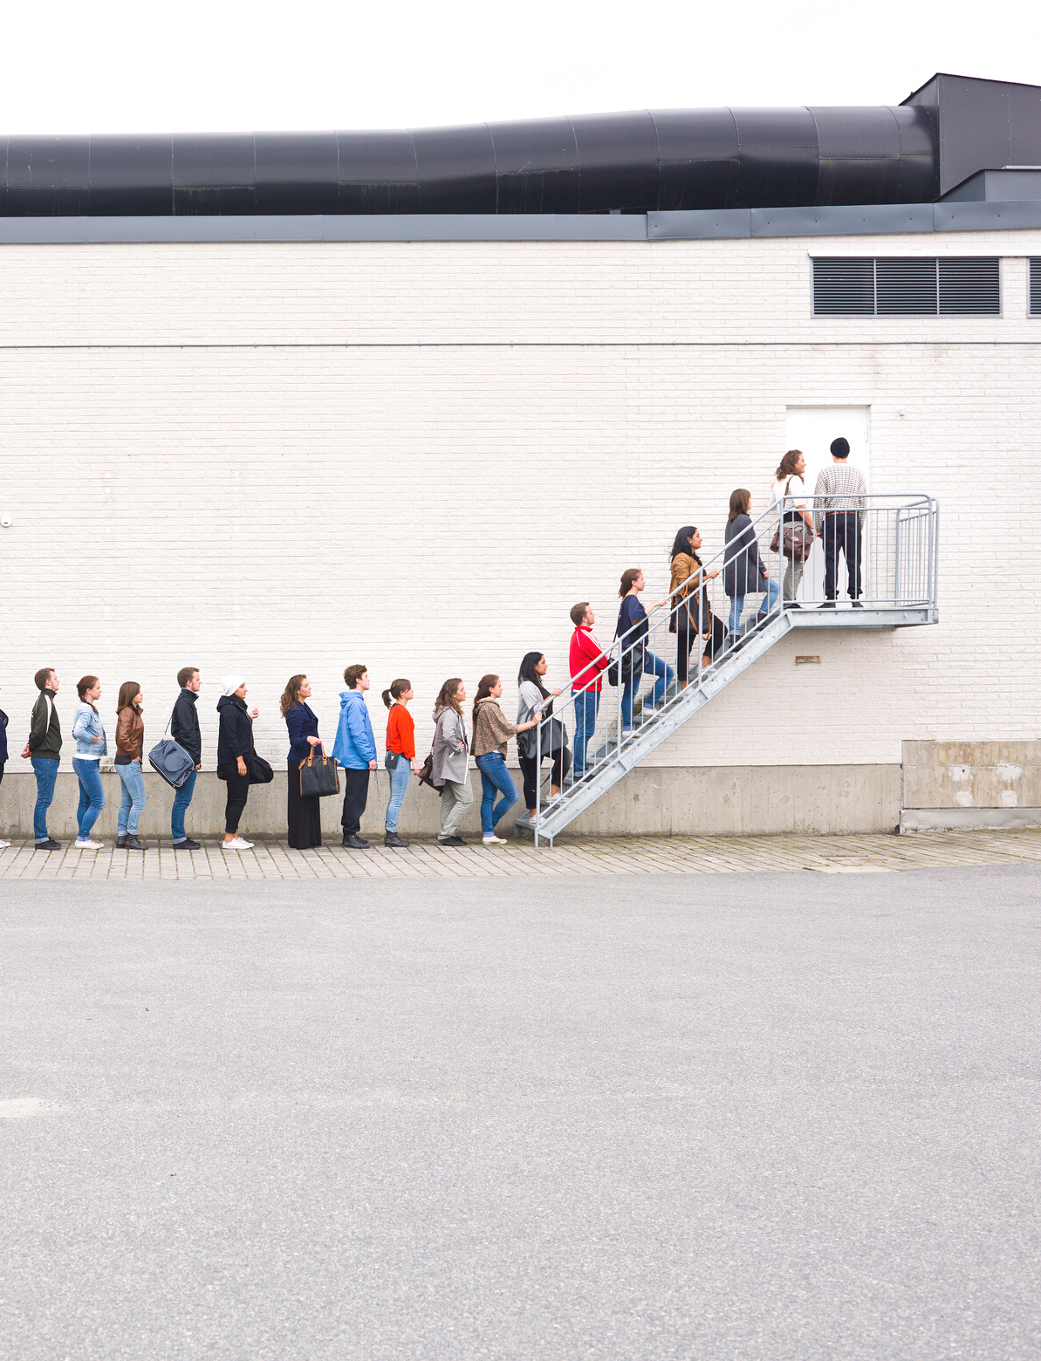

Problem
4.03
Long queues in hospital receptions causing delay in administration of treatment.

Slide 3


Problem
4.03
The process of nurses attending patients involves a lot of paperwork, giving rise to potential inefficiency in handling patient records.

Slide 4


Problem
4.03
Improper management in dealing with patient reports costs more time, putting patients' health under concern.

Slide 5

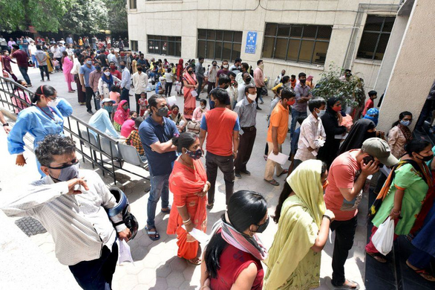
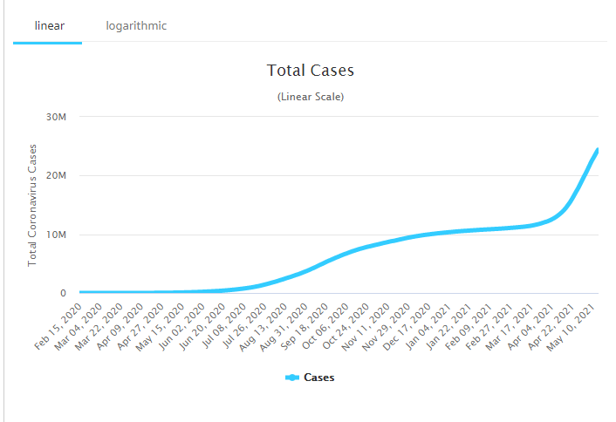
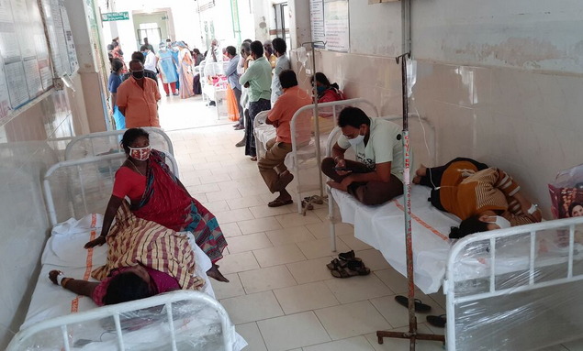


4.03
HOW BIG IS THE PROBLEM?
125
100
75
31 Million Tests Daily
50
25
An ever peaking graph
0
January
February
March
April
Wait time to see a doctor
Average length of line
Overwhelmed hospitals

Slide 6




Solution
4.03
An application that assigns a unique universal QR code to each patient that encrypts his or her medical record.
Each hospital reception would have a QR Code, upon scanning which the patient would be provided an automated appointment with the doctor without having to wait in long queues for the same.
SOLUTION

Slide 7


4.03
HOSPITAL BED QR
Information incorporating each patient's medical record would be transferred temporarily to a QR code associated with the bed he/she occupies at the hospital.

Slide 8
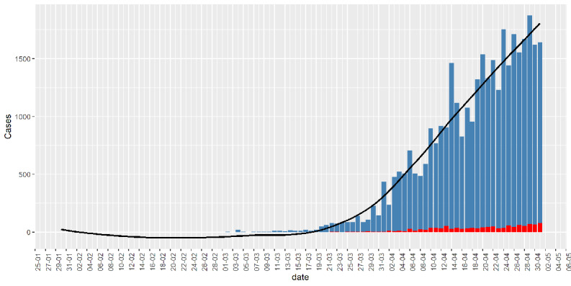



How effective the solution can be
4.03
May
June
July
August
Source: NCBI
0
50
100
150
200
Predicted Graph
Before our Solution
After our Solution
Average line length
Average line length
Patient wait time
Patient wait time

Slide 9
4.03
NO SMARTPHONE
Solution
ON SPOT SOLUTION
irony

Slide 10


4.03
IS THIS ACTUALLY FEASIBLE?
FINANCIAL STATS:
FEASIBLE

Slide 11



4.03
Team
THE DIVERSE TEAM
NIHAR
PARTHA
EISHA
Engineer
Doctor
Doctor

Slide 12
Thank You
CareChief

